Slide 1

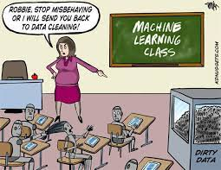
K-Means Algorithm
Dr. Yilmaz
12/4/2023

Slide 2
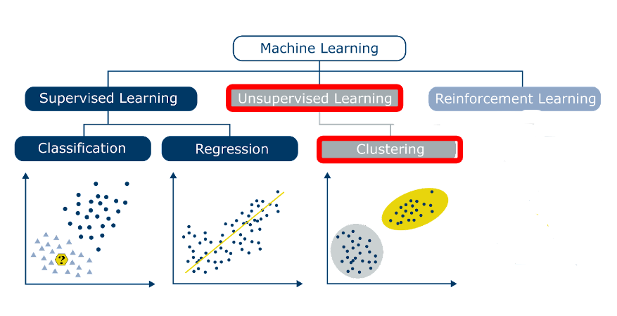

Slide 3
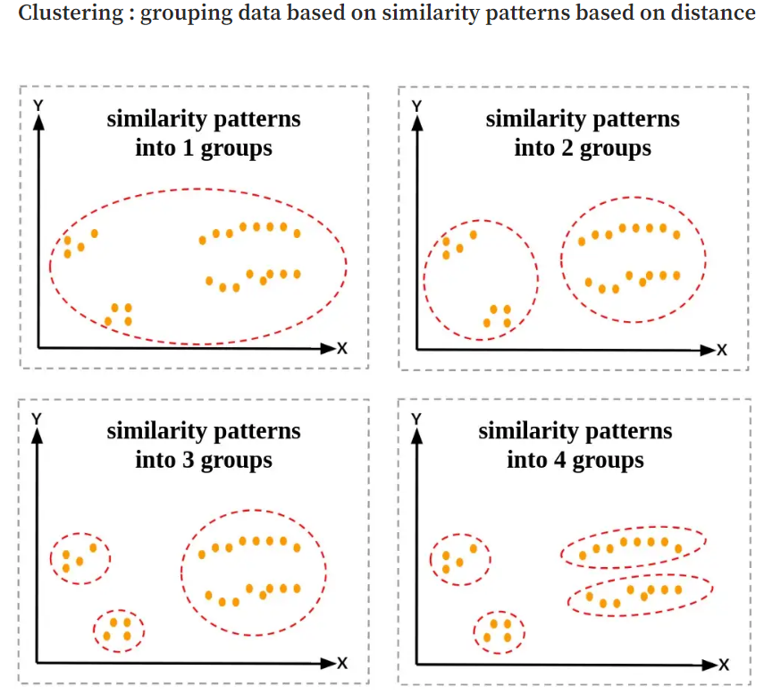
Clustering Intuition
Notes:
https://medium.com/data-folks-indonesia/step-by-step-to-understanding-k-means-clustering-and-implementation-with-sklearn-b55803f519d6

Slide 4
K-Means Algorithm
Step 1: Choose a K K represents the number of centroids (i.e. clusters)
Step 2: Randomly select centroids positions
Step 3: Calculate distances between each data point and K centroids to figure out
the closest cluster and assign each data point to a cluster
Step 4: Calculate the mean of each cluster
Use the mean value as the new centroid
Step 5: Repeat step 3 and 4 until any of the following condition is met:
Centroids of newly formed clusters do not change
Points remain in the same cluster
Maximum number of iterations are reached

Slide 5
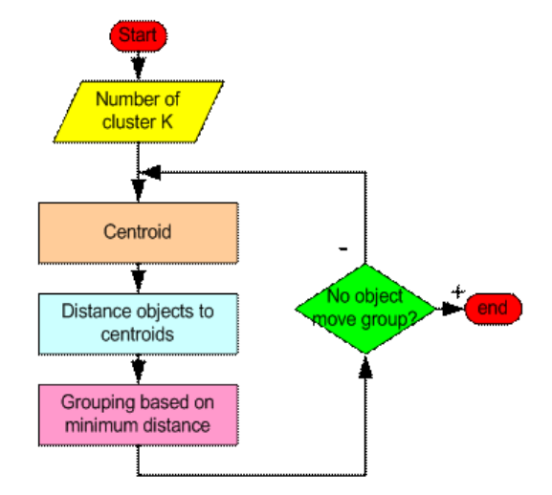
K-means Algorithm FlowChart
Notes:
https://people.revoledu.com/kardi/tutorial/kMean/NumericalExample.htm

Slide 6
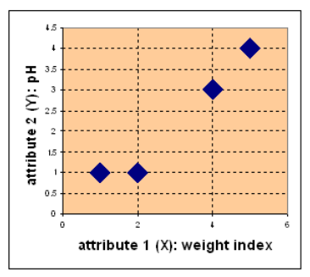
Example
Suppose we have 4 types of medicine, and each medicine is defined using 2 attributes: weight and pH. Our goal is to group these objects into K=2 group based on the given features.
Medicine | weight | pH
A | 1 | 1
B | 2 | 1
C | 4 | 3
D | 5 | 4
Notes:
https://people.revoledu.com/kardi/tutorial/kMean/NumericalExample.htm

Slide 7
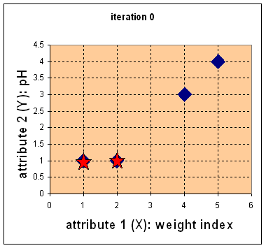
Example (con’t)
Pick centroids c1=(1,1) c2=(2,1)

Slide 8
Example (con’t)
2. Calculate Euclidean distance between each centroid and datapoint (medicine)
Medicine | weight | pH | distance to C1=(1,1) | distance to C2=(2,1)
A | 1 | 1 | 0 | 1
B | 2 | 1 | 1 | 0
C | 4 | 3 | 3.6 | 2.82
D | 5 | 4 | 5 | 4.24
C1 C2

Slide 9
Example (con’t)
3. Cluster meds (i.e. data points) based on minimum distance
Medicine | weight | pH | d to C1=(1,1) | d to C2=(2,1)
A | 1 | 1 | 0 | 1
B | 2 | 1 | 1 | 0
C | 4 | 3 | 3.6 | 2.82
D | 5 | 4 | 5 | 4.24
A is closer to C1
B is closer to C2
C is closer to C2
D is closer to C2

Slide 10
Example (con’t)
4. Iteration 1: Determine new centroids for each group
New Centroid for group 1:
Because there is one element for group 1,
the centroid will be itself.
C1=(1,1)
New Centroid for group 2:
Group 2 has three members, we average its attribute values
C2=((2+4+5)/3, (1+3+4)/3) = (3.7, 2.7)

Slide 11
Example (con’t)
4. Iteration 1: Determine new centroids for each group
New Centroid for group 1:
Because there is one element for group 1,
the centroid will be itself.
C1=(1,1)
New Centroid for group 2:
Group 2 has three members, we average its attribute values
C2=((2+4+5)/3, (1+3+4)/3) = (3.7, 2.7)

Slide 12
Example (con’t)
5. Iteration 1: Calculate Euclidean distance between each centroid and datapoint (medicine) to re-cluster
Medicine | weight | pH | d to C1=(1,1) | d to C2=(3.7,2.7)
A | 1 | 1 | 0 | 3.14
B | 2 | 1 | 1 | 2.36
C | 4 | 3 | 3.6 | 0.47
D | 5 | 4 | 5 | 1.89
A is closer to C1
B is closer to C1
C is closer to C2
D is closer to C2

Slide 13
Example (con’t)
6. Iteration 1: Clustered meds based on the minimum distance

Slide 14
Example (con’t)
7. Iteration 2: Determine new centroids for each group
Centroid for group 1:
C1=((1+2)/2, (1+1)/2) = (1.5, 1)
Centroid for group 2:
Group 2 has three members, we average its attribute values
C2=((4+5)/2, (3+4)/2) = (4.5, 3.5)

Slide 15
Example (con’t)
7. Iteration 2: Determine new centroids for each group

Slide 16
Example (con’t)
8. Iteration 2: Calculate Euclidean distance between each centroid and datapoint (medicine) to recluster
Medicine | weight | pH | d to C1= (1.5, 1) | d to C2=(4.5, 3.5)
A | 1 | 1 | 0.5 | 4.3
B | 2 | 1 | 0.5 | 3.5
C | 4 | 3 | 3.2 | 0.7
D | 5 | 4 | 4.6 | 0.7
A is closer to C1
B is closer to C1
C is closer to C2
Groups did not change!
D is closer to C2

Slide 17
Example (con’t)
Resulting groups

Slide 18
Visualizing k-means
Have fun!
https://www.naftaliharris.com/blog/visualizing-k-means-clustering/

Slide 19
K-Means: Advantages and Disadvantages
Advantages:
Easy to implement.
K-means model dynamically updated: centroid can be updated if new dataset is added.
Disadvantages:
Hard to guess K
K-means is time consuming. Need to calculate distances between new centroid in every loop.
Works only for quantitative continuous data.
Initial centroid can impact results.
K-means method may not find out the global best solution. It sometimes returns local optimum.
K-means is limited to linear cluster boundaries.

Slide 20
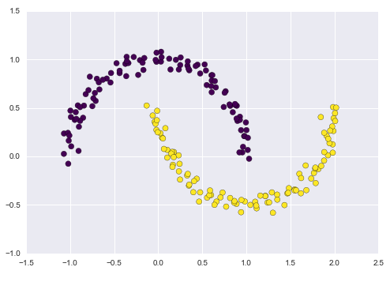
“K-means is limited to linear cluster boundaries”
What does it mean?
Assumes:
points will be closer to their own cluster center than to others
ineffective if the clusters have complicated geometries

Slide 21
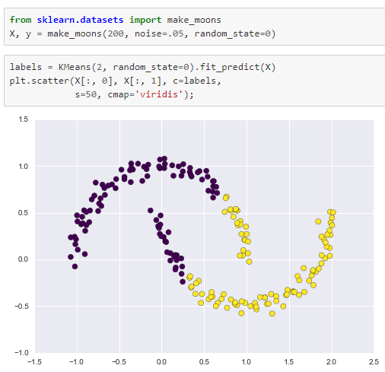
“K-means is limited to linear cluster boundaries”
What does it mean?
Assumes:
points will be closer to their own cluster center than to others
ineffective if the clusters have complicated geometries

Slide 22
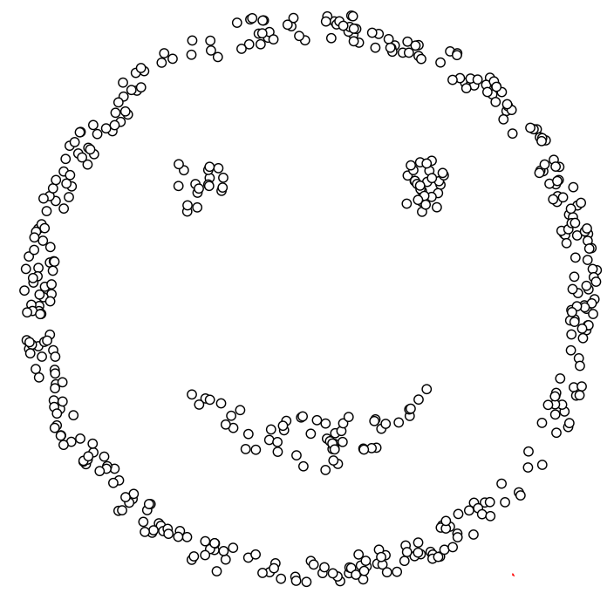
“K-means is limited to linear cluster boundaries”
Notes:
https://www.naftaliharris.com/blog/visualizing-k-means-clustering/ Option: I’ll choose-> Smiley face

Slide 23
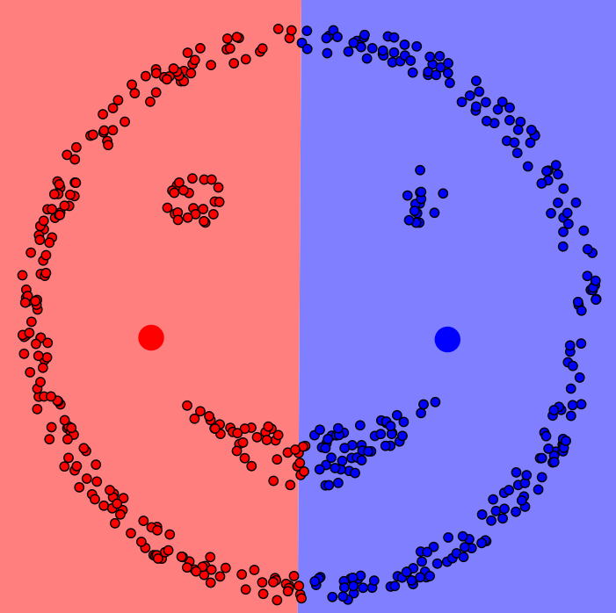
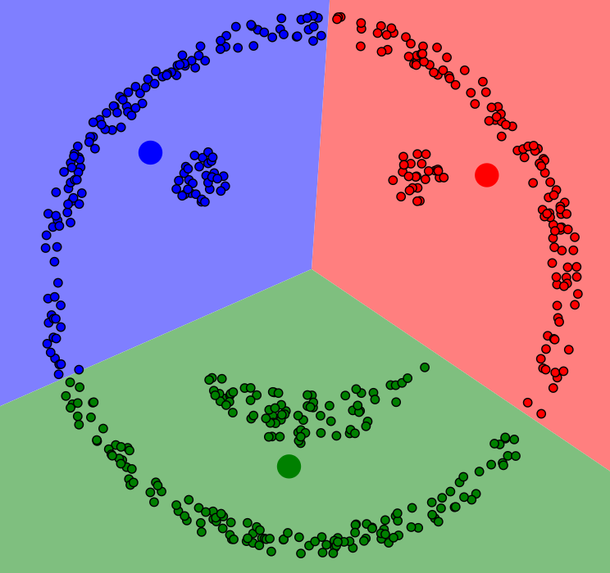
“K-means is limited to linear cluster boundaries”
k=2 k=3

Slide 24
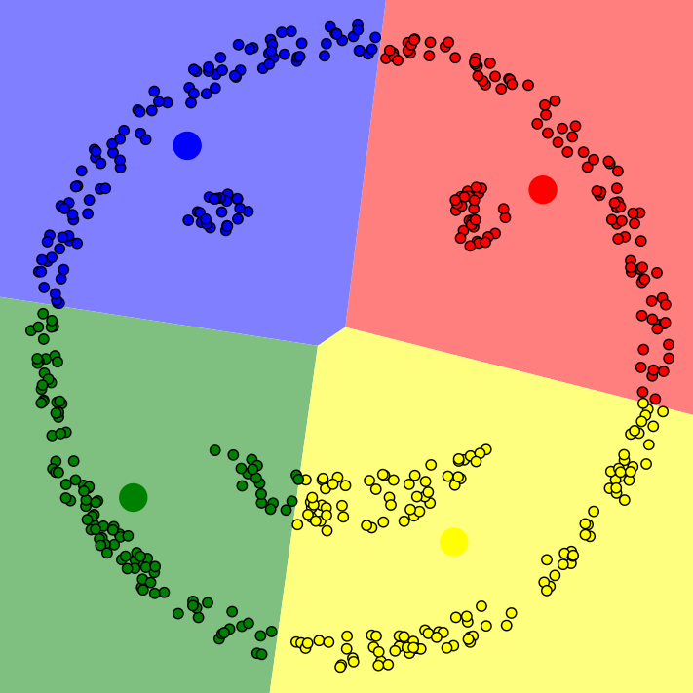
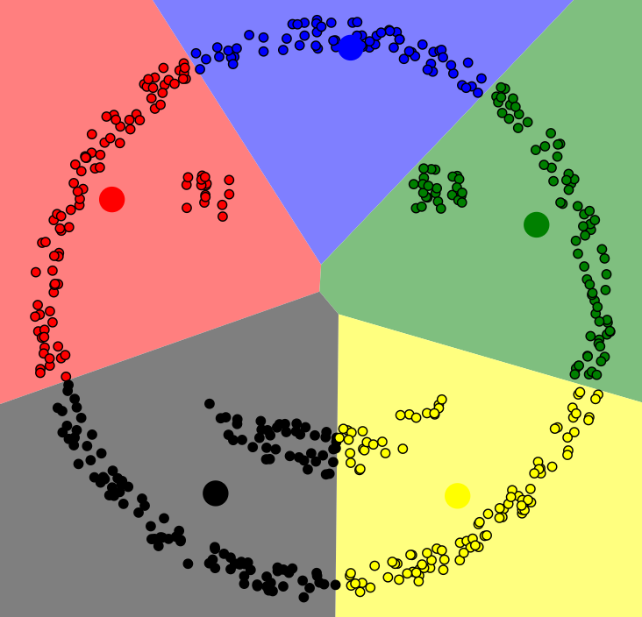
“K-means is limited to linear cluster boundaries”
k=4 k=5

Slide 25
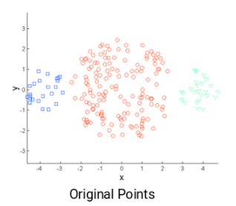
Other Challenges: Different Cluster Sizes
How will K-means cluster this data?
Notes:
Even if you assign centroid blue to further left, and centroid green to furthest right, during the next iteration, new centroids will be pushed inward toward the center. Won’t help.
https://www.analyticsvidhya.com/blog/2019/08/comprehensive-guide-k-means-clustering/

Slide 26
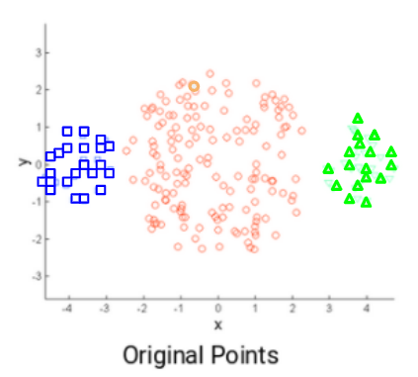
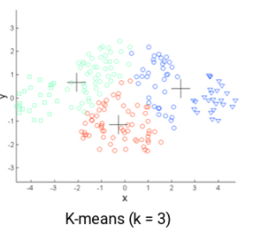
Other Challenges: Different Cluster Sizes
How will K-means cluster this data?

Slide 27
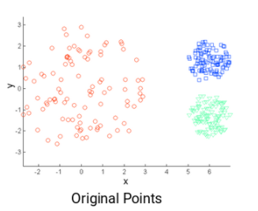
What about this one? For k=3
Data with different densities

Slide 28
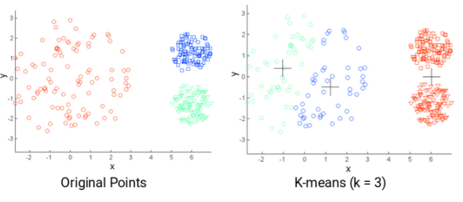
What about this one?
We can see that the compact points have been assigned to a single cluster. Whereas the points that are spread loosely but were in the same cluster have been assigned to different clusters.
Will increasing the value of k improve the result?

Slide 29
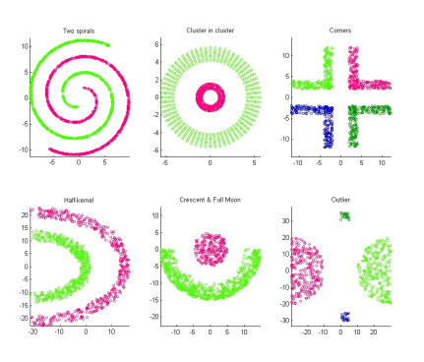
Challenging Clusters

Slide 30
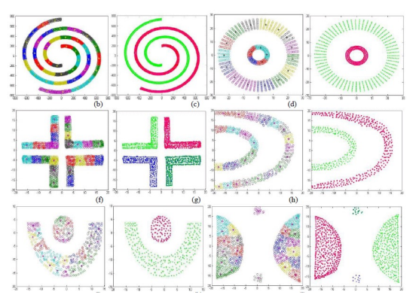
Challenging Clusters

Slide 31
How to measure accuracy?
K-means algorithm is not using labels, i.e unsupervised
How can we measure its performance?
Accuracy?

Slide 32
References:
https://jakevdp.github.io/PythonDataScienceHandbook/05.11-k-means.html
http://cs229.stanford.edu/notes2021fall/lecture12-kmeans.pdf
https://www.analyticsvidhya.com/blog/2019/08/comprehensive-guide-k-means-clustering/

